Slide 1
COMPUTER ORGANIZATION AND ARCHITECTURE
Dr. Rizwan Khan
Head – Department of Computer Science and Engineering
(An NBA Accredited Program)
ABES Institute of Technology, Ghaziabad

Slide 2
Virtual Memory
Virtual memory was developed to give programs a larger memory space than the system’s main memory. The appearance of larger address space is realized by using much slower disk storage.
The concepts and the principal implementation techniques are very similar to the cache systems discussed in the last chapter. In implementing virtual memory, the main memory and disk are divided into fixed size pages. A mapping table called a page table does the mapping of pages between the disk and main memory.

Slide 3
VIRTUAL MEMORY
In a memory hierarchy system, programs and data are first stored in auxiliary memory. Portions of a program or data are brought into main memory as they are needed by the CPU.
Virtual memory permits the user to construct programs as though a large memory space were available, equal to the totality of auxiliary memory.
Each address that is referenced by the CPU goes through an address mapping from the so-called virtual address to a physical address in main memory.
Virtual memory is used to give programmers the illusion that they have a very large memory at their disposal, even though the computer actually has a relatively small main memory.
A virtual memory system provides a mechanism for translating program-generated addresses into correct main memory locations. This is done dynamically, while programs are being executed in the CPU. The translation or mapping is handled automatically by the hardware by means of a mapping table.

Slide 4
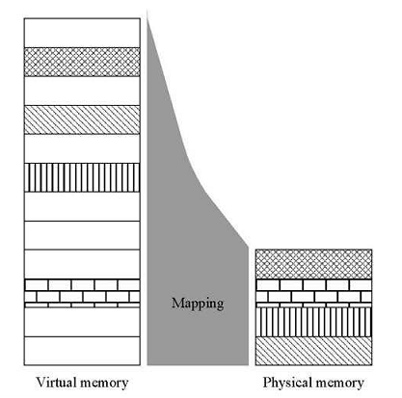
VIRTUAL MEMORY
Virtual Memory
Address Space(Logical) and Memory Space(Physical)
address space
memory space
virtual address
(logical address)
Mapping
physical address
address generated by programs actual main memory address
Thus the address space is the set of addresses generated by programs as they reference instructions and data;
the memory space consists of the actual main memory locations directly addressable for processing.
In most computers the address and memory spaces are identical.
The address space is allowed to be larger than the memory space in computers with virtual memory.
Address Space
Memory Space

Slide 5
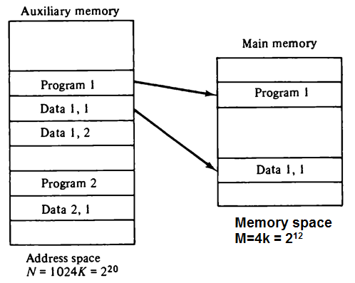
Example
Main Memory Capacity = 4K words ➔ needs 12 bits to specify a physical address
Auxiliary Memory = 1024K words ➔ can support 20 bit addresses.

Slide 6
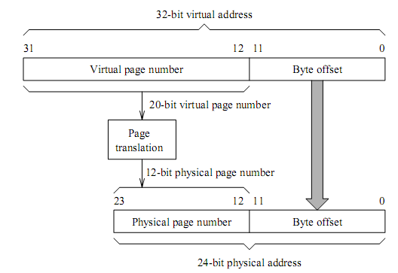
ADDRESS MAPPING

Slide 7
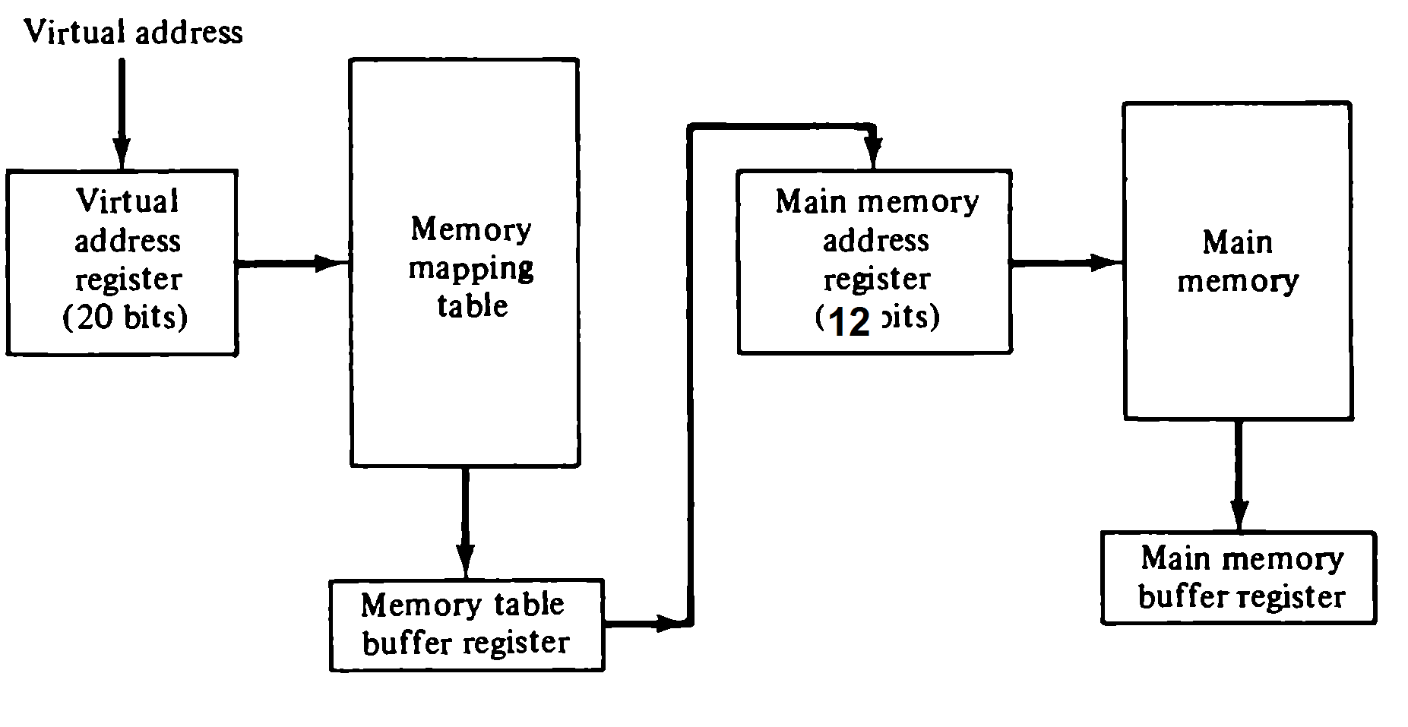
MEMORY MAPPING TABLE
Virtual Memory

Slide 8
Pages and Blocks
Physical memory is broken down into groups of equal size called BLOCKS
The groups of address space of same size are called PAGES.
a page refers to the organization of address space, while a block refers to the organization of memory space.
In previous example address space is divided into 1024 pages and main memory is divided into 4 blocks.
The programs are also split into pages.
Portions of programs are moved from auxiliary memory to main memory in records equal to the size of a page.

Slide 9
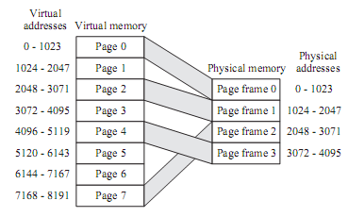
EXAMPLE

Slide 10
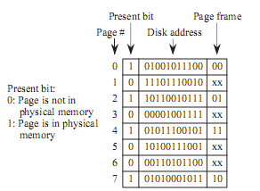
EXAMPLE

Slide 11
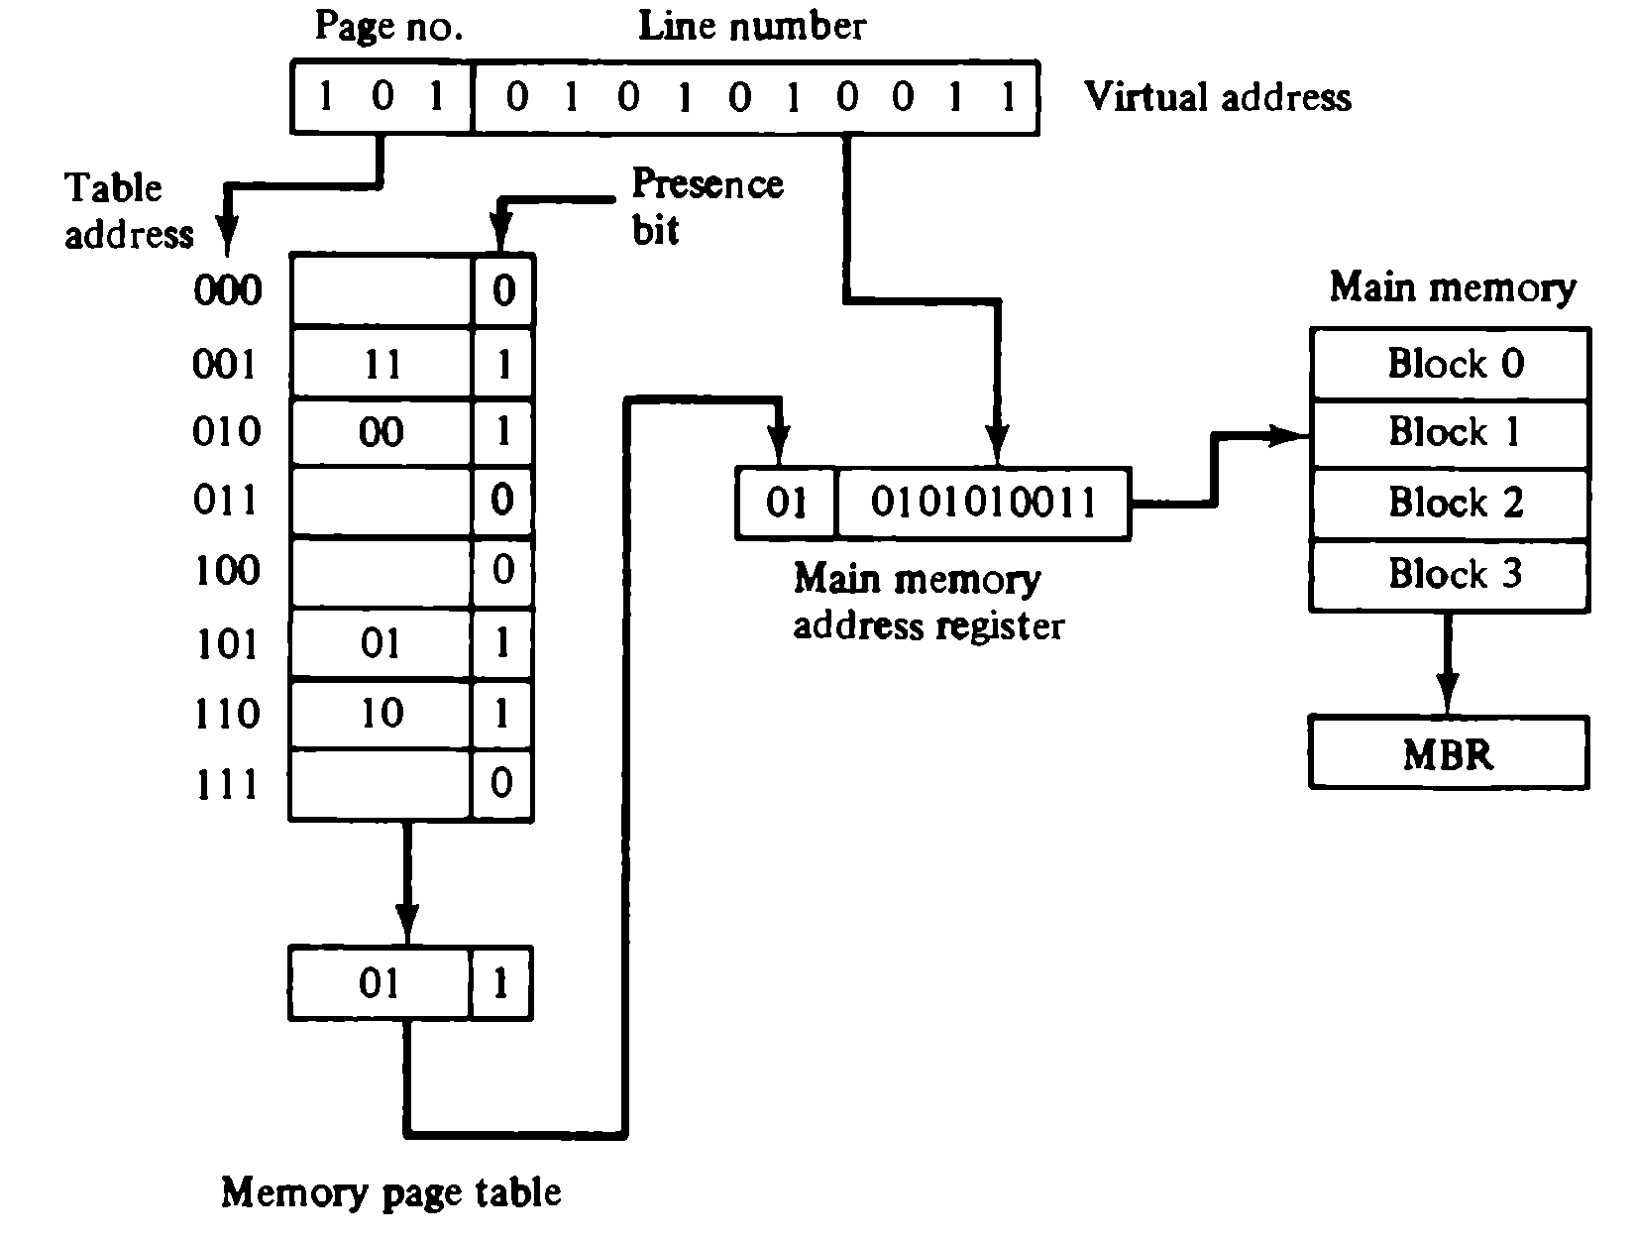
Memory Table in a paged system

Slide 12
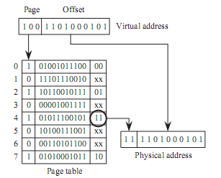
EXAMPLE

Slide 13


